Slide 1
El Paso HMIS Steering Committee Meeting “The More You Know”
December 2023
epchomeless.org

Slide 2
What Will Be Covered?
Clarity Feature Update – November & December 2023
2023 EPCH HMIS Survey
2024 HUD Data Standards – How’s it going?
Conclusion/Questions

Slide 3
Clarity Update-November 2023
November 2023 update went live on November 13th, 2023.
Most of this month's updates focus on the ability to edit referral dates.
New Update
Now Live!

Slide 4
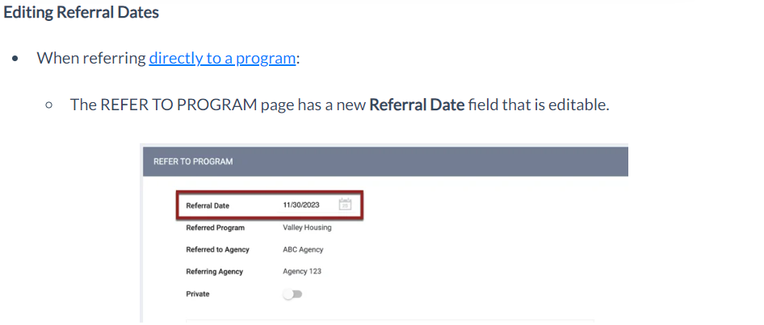
Clarity Update-Edit Referral
CE Staff has the ability to change the referral date in certain cases.
This should only be used in unique situations only.
If you need a referral date changed, get with Alex or Denver.

Slide 5
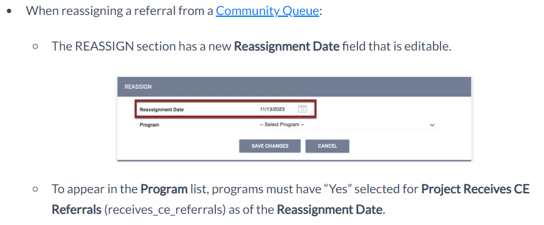
Clarity Update-CQ Reassign Date
If a client had been assigned to the Community Queue and you add the client to your program, you can adjust the reassign date to match the date of enrollment.

Slide 6
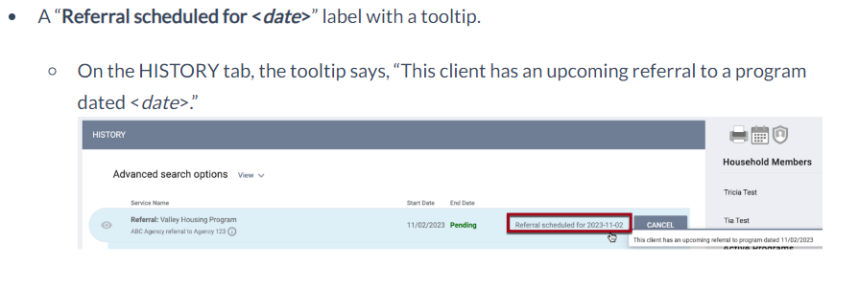
Clarity Update-Future Date
CE staff now has the ability to send a referral for a “Future Date”.
You will see the referral states when it is scheduled.

Slide 7
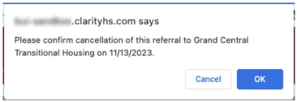
Clarity Update-Future Date
You can also Cancel a referral that has a Future Date.
If a user clicks the CANCEL button, a pop-up appears for the user to confirm the cancellation of the referral to the program.
If the user clicks OK, the referral will be deleted from the HISTORY tab and will not be created/reassigned on that future date.
Canceling the referral acts the same as deleting that referral (i.e., a canceled referral won’t be recorded as a “Denied” referral because it technically hasn’t happened yet).
Reports will distinguish between a deleted referral and a canceled referral.

Slide 8
Clarity Update-December 2023
December 2023 update went live on December 11th, 2023.
This month’s update focused on Security Measures.
New Update
Now Live!

Slide 9
Clarity Update-Security Measures
Clarity has implemented additional Security Measures for increased security within Clarity Human Services.
If, while a user is logged in, there is a change to their primary agency or their access role (either for their main role or for their role in an additional agency), the system will log the user out.
When a user’s password is changed (either by the user or by a system administrator), the end user’s previous “session identifiers” (the unique numbers assigned by the server for the duration of the user’s session) are all made invalid.
Users who change their own passwords in their ACCOUNT SETTINGS will not be logged out of their current session.
When a user resets their password using the FORGOT PASSWORD function, the system will log the user out wherever they are currently logged in.

Slide 10
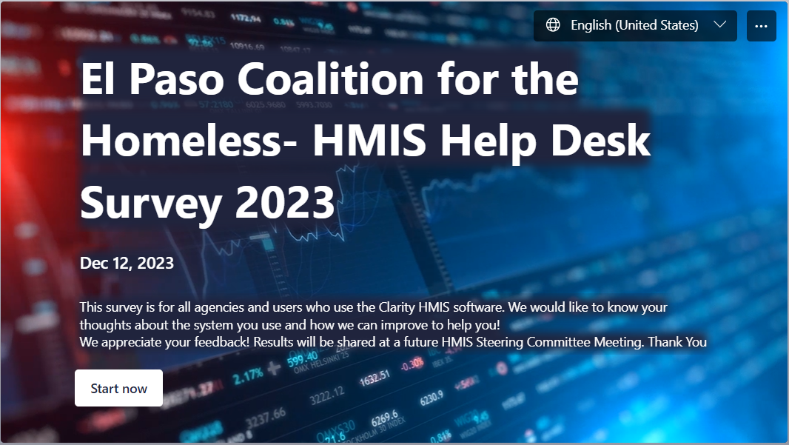
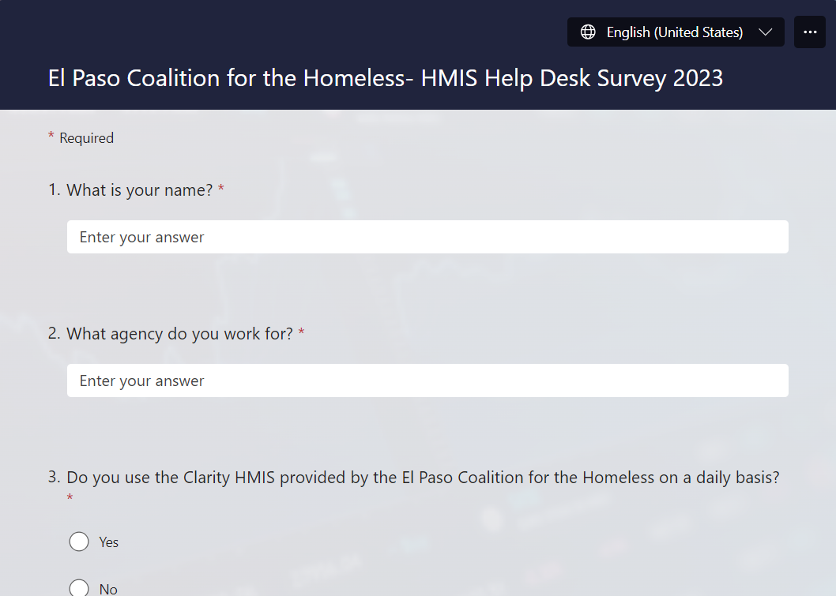
2023 EPCH HMIS Survey
We will be sending out the 2023 HMIS Survey immediately after todays HMIS Steering Committee Meeting!
Please complete the survey as soon as possible.
Last day to complete will be January 5th, 2024.
Individual results will not be shared. We will gather all answers and show the total results in next month’s HMIS meeting.

Slide 11
2024 HMIS Data Standards
The new 2024 HUD HMIS Data Standards are live!
Review of the changes:
Client Refused → Client Prefers Not To Answer
Gender: Man (Boy) Woman (Girl)
Race & Ethnicity: Combined. Added Middle Eastern/N. African.
Translation Assistance Needed: New Question for all programs!
Prior Living Situation/Destination: Rental By Client with Ongoing Subsidy: Subsidy Type- MUST Provide what kind of Subsidy.
HMIS Reports-All reports in BETA have been tested and are ready to use for submission!
Any questions on the new 2024 Data Standards?

Slide 12
Conclusion
Both November and December updates are now live!
Please complete the 2023 HMIS Survey as soon as possible. We appreciate your thoughts and comments on the system and how we are doing!
If you run into anything new due to the recent HUD HMIS Data Standard updates, please reach out to us so we can help!
Any Questions?

Slide 13
EPCH HMIS “Eyes on the Fries!”
HMIS Zoom Lunch Meeting!
Open to anyone who needs help or has questions with HMIS!
Zoom meeting will be from 11:30am-1:30pm
Next meeting is on Friday 1/19/24!
Bring your questions, concerns and lunch!
Hosted by Denver Herald (HMIS Tech)
Hope To See You There!

Slide 14
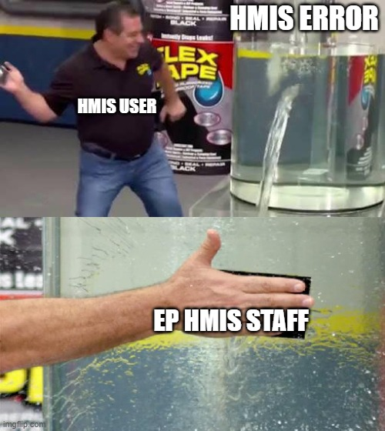
Thank you!
EPCH Contact Information:
-Gary Gray-HMIS Senior Administrator
ggray.epch@elp.twcbc.com
-Denver Herald- HMIS Support Technician
dherald.epch@elp.twcbc.com
-EPCH Phone Number (Office Hours: M-F 8am-5pm)
(915) 843-2170
WE ARE HERE TO HELP!

